Slide 1
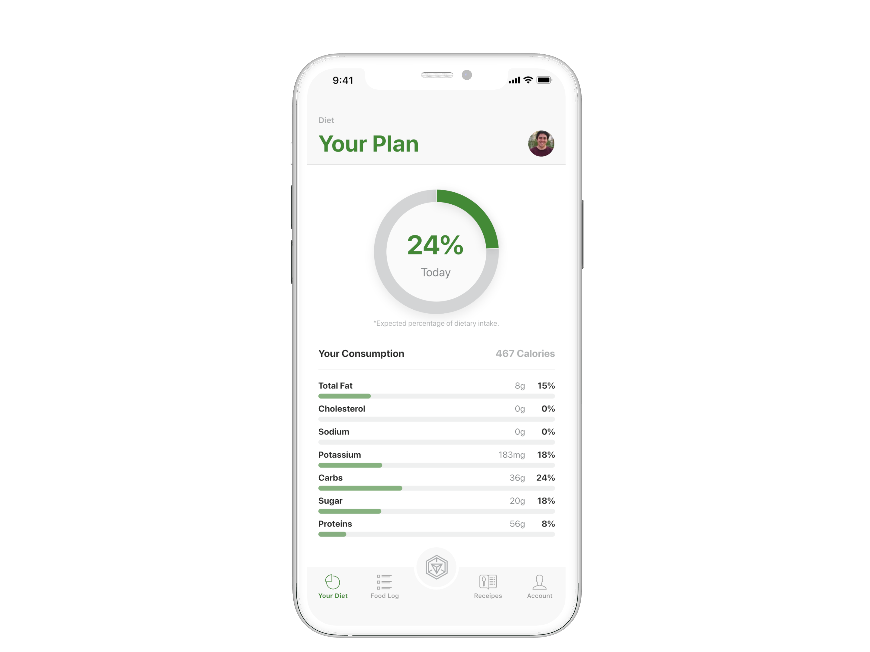

AR for your eating

Slide 2

Problem Statement
How can we make better eating decisions?

Slide 3
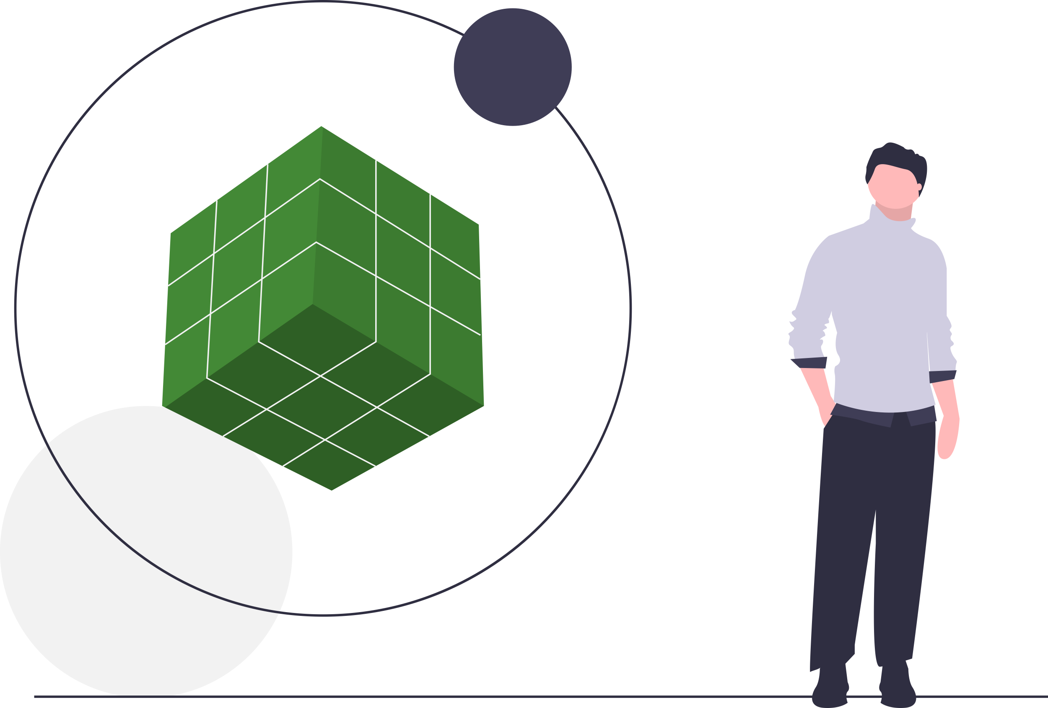
The Solution
AR food Scanner and Nutrition Advisor

Slide 4
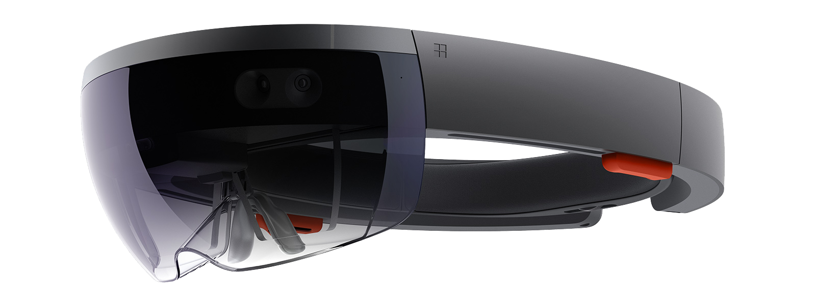
Testing
HoloLens Tech Demo

Slide 5
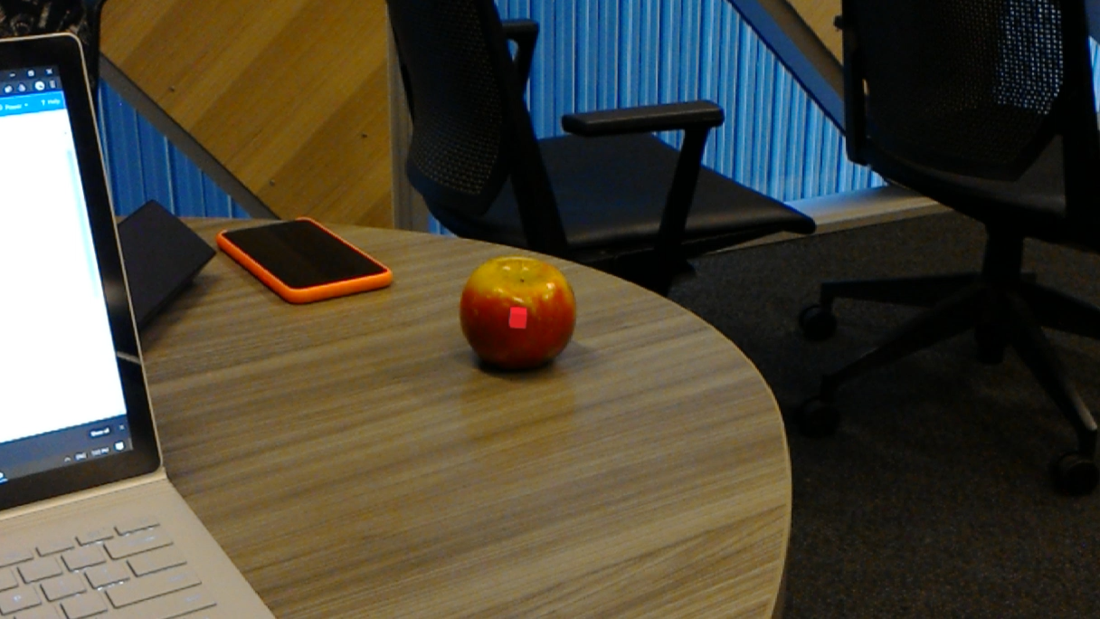

Slide 6
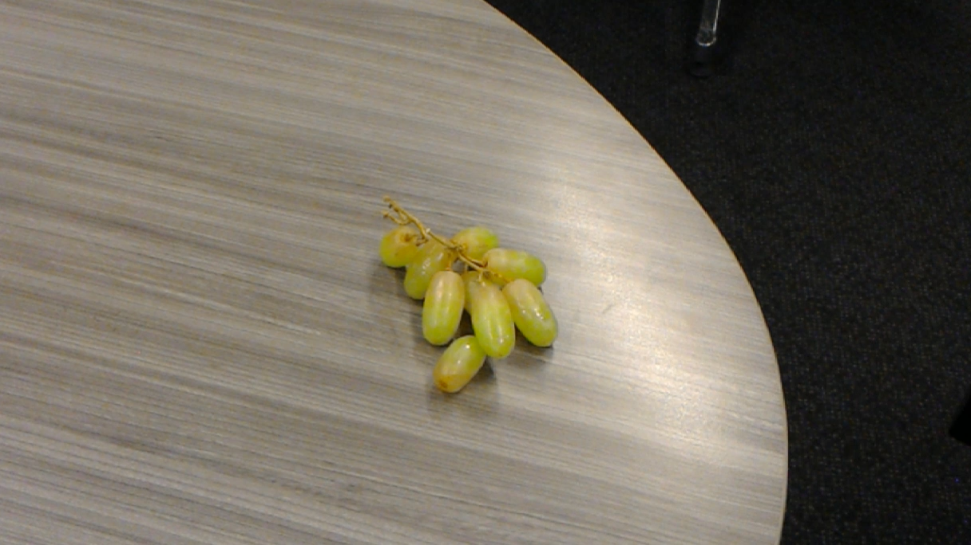

Slide 7

HoloLens

Slide 8
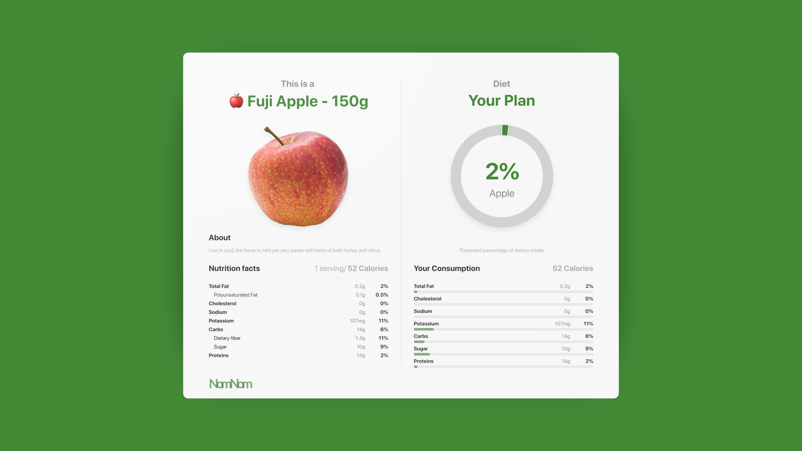

HoloLens - Hologram

Slide 9
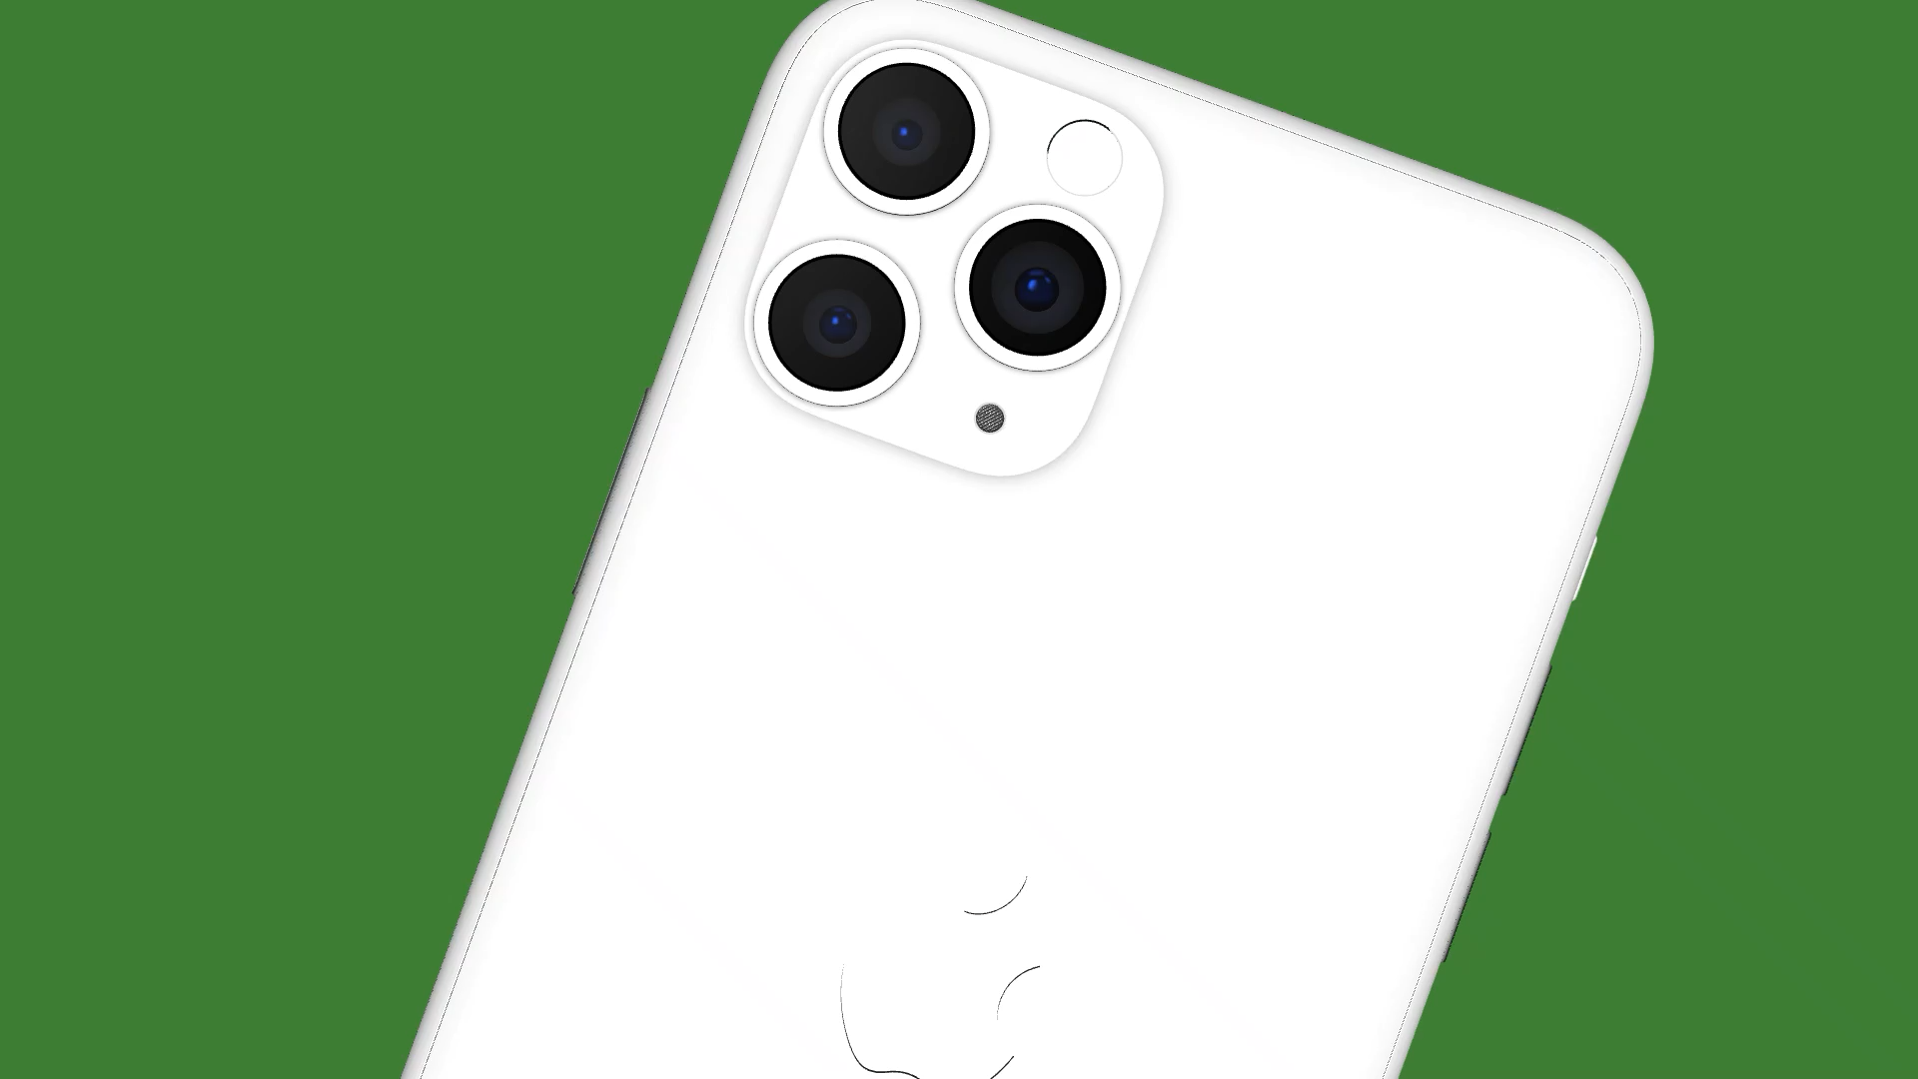

Slide 10
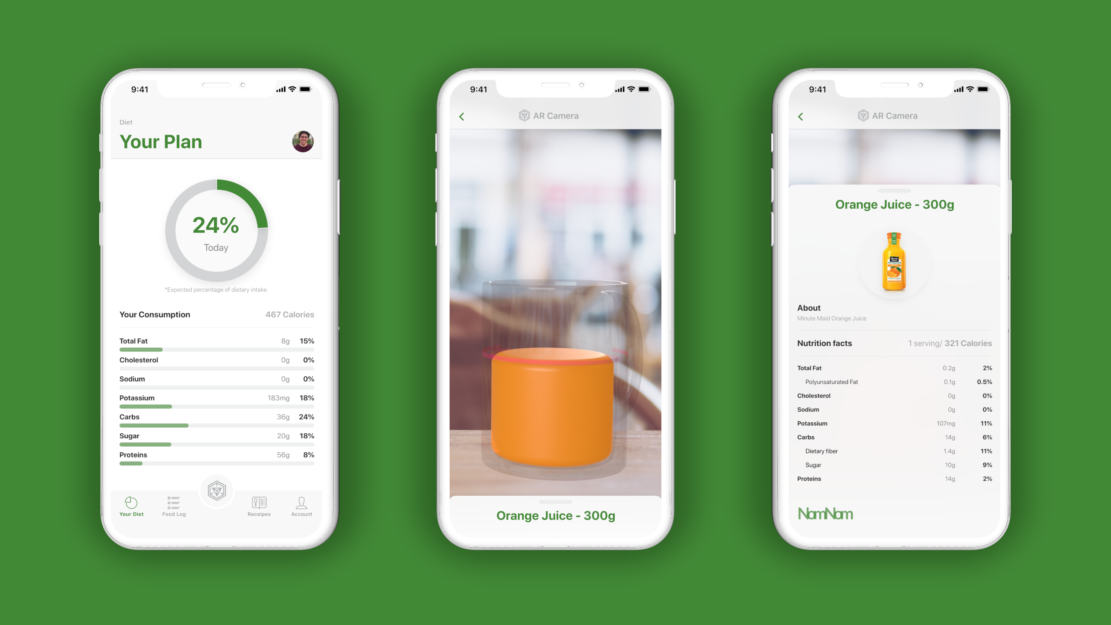

iPhone – AR Kit

Slide 11

Into the Future
Business Model and additions into the future

Slide 12

Q&A
Want to know more about NomNom?

